Slide 1
ACA SAS SIG Meeting
July 13, 2022

Slide 2
Agenda
Introduction of SIG officers
Nominations for OFFICERS
  See Kristine Steven’s attachment to email sent on 5/21/2023
Last years’ activities
This year’s activities
Next year’s activities
Workshop proposals for 2024 meeting
  Deadline for workshops is September 1, 2023
Session proposals for 2024 meeting
  Deadline for proposals is June 30, 2023
Set time and day for SIG social hour
Every SIG must cover the topics in bold and red

Slide 3

Current SAS SIG officers (executive committee)
A
B
C
Person A
(Affiliation)
Chair (CURRENT)
2022-2023
Person B
(Affiliation)
Chair-Elect (UPCOMING)
2023-2024
Person C
(Affiliation)
Secretary Treasurer (CURENT)
2023-2024

Slide 4
Role of the Chair-Elect
Two-year commitment: chair-elect becomes chair after one year.
As chair-elect you will:
Co-organize SAS SIG activities for the 2023 meeting with chair
Stand in for chair if necessary
As chair you will:
Attend and advocate for SAS SIG sessions at the 2024 ACA planning meeting (held in 2023)
Facilitate SAS SIG activities at the 2024 meeting
Also, together with other members of SIG executive committee:
Attend ACA planning session (following annual ACA meeting)
Write annual SIG report for ACA
Select Etter Student Lecture Award winner

Slide 5
Role of the Secretary Treasurer
Two-year commitment
As Secretary Treasurer you will:
Take meeting minutes to give to the SIG chair for their council report.
  You will have access to the Zoom recording to aid in creating the minutes.
Help coordinate fundraising for sessions and workshops.

Slide 6
Nominations
Nominations for Chair-elect:
???
???
Nominations for Secretary Treasurer:
???
???

Slide 7
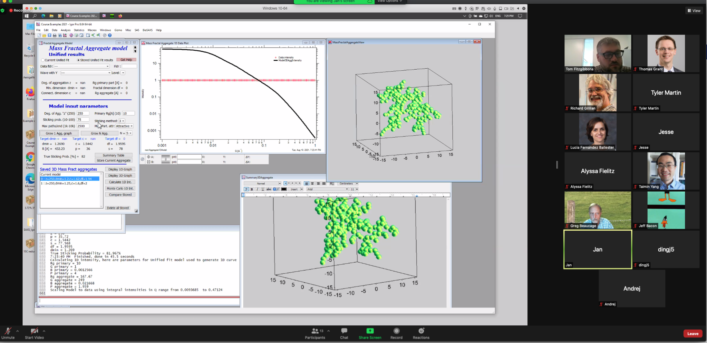
Review SIG activities from past years
EXAMPLE from SAS SIG 2021
Workshops (14 attendees, 5 instructors):
Characterization of Soft Materials Via Small
Angle Scattering: Applications of Scattering
for Polymer Systems
  Organizer: Thomas Fitzgibbons
Sessions:
Mapping Free Energy Landscapes of Molecular Machines (40)
  Chairs: Kara Zielinski & Kevin Dalton
Evolving Enzymes (42)
  Chairs: Audrey Burnim & Ben Clifton
Membrane Protein Structure in Membrane and Membrane-mimic Environments (23)
  Chairs: Kushol Gupta & Venky Pingali
Self Assembly in Soft Matter Systems (21)
  Chairs: Thomas Fitzgibbons & Volker Urban
BioWAXS: Experiment & Interpretation (49)
  Chairs: Steve Meisburger & Jochen Hub

Slide 8
Review SIG activities from past years
EXAMPLE from SAS SIG 2022
Workshops:
WK1: Applications of Small Angle Scattering to Structural Biology: An Introduction (14 registered)
  Organizer: Michal Hammel
Sessions:
Better Understanding Semicrystalline Polymers using complementary structure methods
  Chairs: Tom Fitzgibbons
John Spence Memorial Session
  Chairs: Richard Kirian
Scanning Imaging and Tomography Based on Scattering Contrast
  Chairs: Lin Yang & Masa Fukuto
Time-resolved Structural Dynamics and Kinetic Processes (Hybrid)
  Chairs: Tom Grant, Venky Pingali, & Wellington Leite
Frontiers in SAS
  Chairs: Jesse Hopkins & Max Watkins
Phase separation and aggregation of bimolecular systems and intrinsically disordered proteins
  Chairs: Richard Gillilan & Yun Liu

Slide 9
Review of Awards at SIG Sponsored Sessions
Example from 2022 SAS SIG
Judith Flippen Anderson Memorial Lecture Award
  Sponsored by Structural Dynamics
  Session: Time-resolved Structural Dynamics and Kinetic Processes
Etter Student Lecturer Award (SAS SIG)
  Session: Phase separation and aggregation of bimolecular systems and intrinsically disordered proteins
Etter Student Lecturer Award (Powder SIG)
  Session: Time-resolved Structural Dynamics and Kinetic Processes

Slide 10
Workshop for next year?
Review Previous workshops:
EXAMPLE provided from SAS
2022: Applications of Small Angle Scattering to Structural Biology: An Introduction
2021: Characterization of Soft Materials Via Small Angle Scattering: Applications of Scattering for Polymer Systems
2020: Applications of Small Angle Scattering to Structural Biology: An Introduction
2019: [none]
2018: Applications of Small Angle Scattering to Structural Biology: An Introduction
2017: [none]
2016: Computational Approaches to Structural Modeling of Biological Macromolecules using SAS
2015: SAS: Structural Biology and Soft Matter
Proposed:
???

Slide 11
Proposed sessions for next year?
A list of proposed sessions would be here. You need a title and no less than two committed chairs

Slide 12
Review Past sessions
If helpful to discussion of proposed sessions
2019
Transactions – Best Data Practices: Current State and Future Needs
Macromolecular Structure Under Physiological Conditions
Morphological Characterization of Porous Materials
Understanding Polymer Structure and Dynamics During and After Processing
Diffuse Scattering for Biological Structure and Dynamics
Structural Biology Combining Solution SAS and High Resolution Methods
SAS Contrast Methods in Biology and Soft Matter
In situ and operando Characterization of Functional Films
2018
Hybrid Techniques
Next Gen Sources/SAS at New Sources
Scattering Strategies in Biomembrane Research
Application of SAS to Complex Materials
Regulation of protein function by shape shifting
2017
Hybrid Methods – BioSAXS
Porous Materials
Integrative approaches to Structural Biology
Advanced Surface and Interface Scattering and Applications
Enabling New Science with Light Sources and Hybrid Methods: Metalloproteins
Frontiers in SAS
2016
Hybrid Methods for Structural Biology
What to do with SAS Data
Surfaces and Interfaces
Making Sense of Diffuse Scattering
SAS and Integrative Approaches to Complex Structure
SAS in Broad Spectrum: Chemistry and Morphology in Complex Soft Materials
2022
Better Understanding Semicrystalline Polymers using complementary structure methods
John Spence Memorial Session
Scanning Imaging and Tomography Based on Scattering Contrast
Time-resolved Structural Dynamics and Kinetic Processes
Frontiers in SAS
Phase separation and aggregation of bimolecular systems and intrinsically disordered proteins
2021
Mapping Free Energy Landscapes of Molecular Machines
Evolving Enzymes
Membrane Protein Structure in Membrane and Membrane-mimic Environments
Self Assembly in Soft Matter Systems
BioWAXS: Experiment & Interpretation
2020
Frontiers in SAS
Structural Dynamics I. Protein Collective Motions Studied by X-ray Scattering and Diffraction
Structural Dynamics II. Conformational Ensembles of Proteins Studied by Cryo-EM and X-ray Scattering

