Slide 1
Origins of Structural Biology and Trials and Errors in its History an idiosyncratic view by Donald Caspar American Crystallographic Association 2012
Notes:
I trace the origins of what is now called Structural Biology to 1927, when J D Bernal and W T Astbury were about to leave the Royal Institution laboratory of W H Bragg (the father) and embark on their own careers. They had agreed: Astbury would do fibers and Bernal crystals of biological molecules.
No celebrations yet mark this 1927 event unlike the anniversaries of my January, 1927 birth,

Slide 2
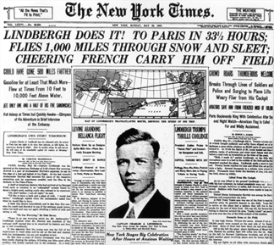
Notes:
Lindbergh's May 1927 flight across the Atlantic,

Slide 3
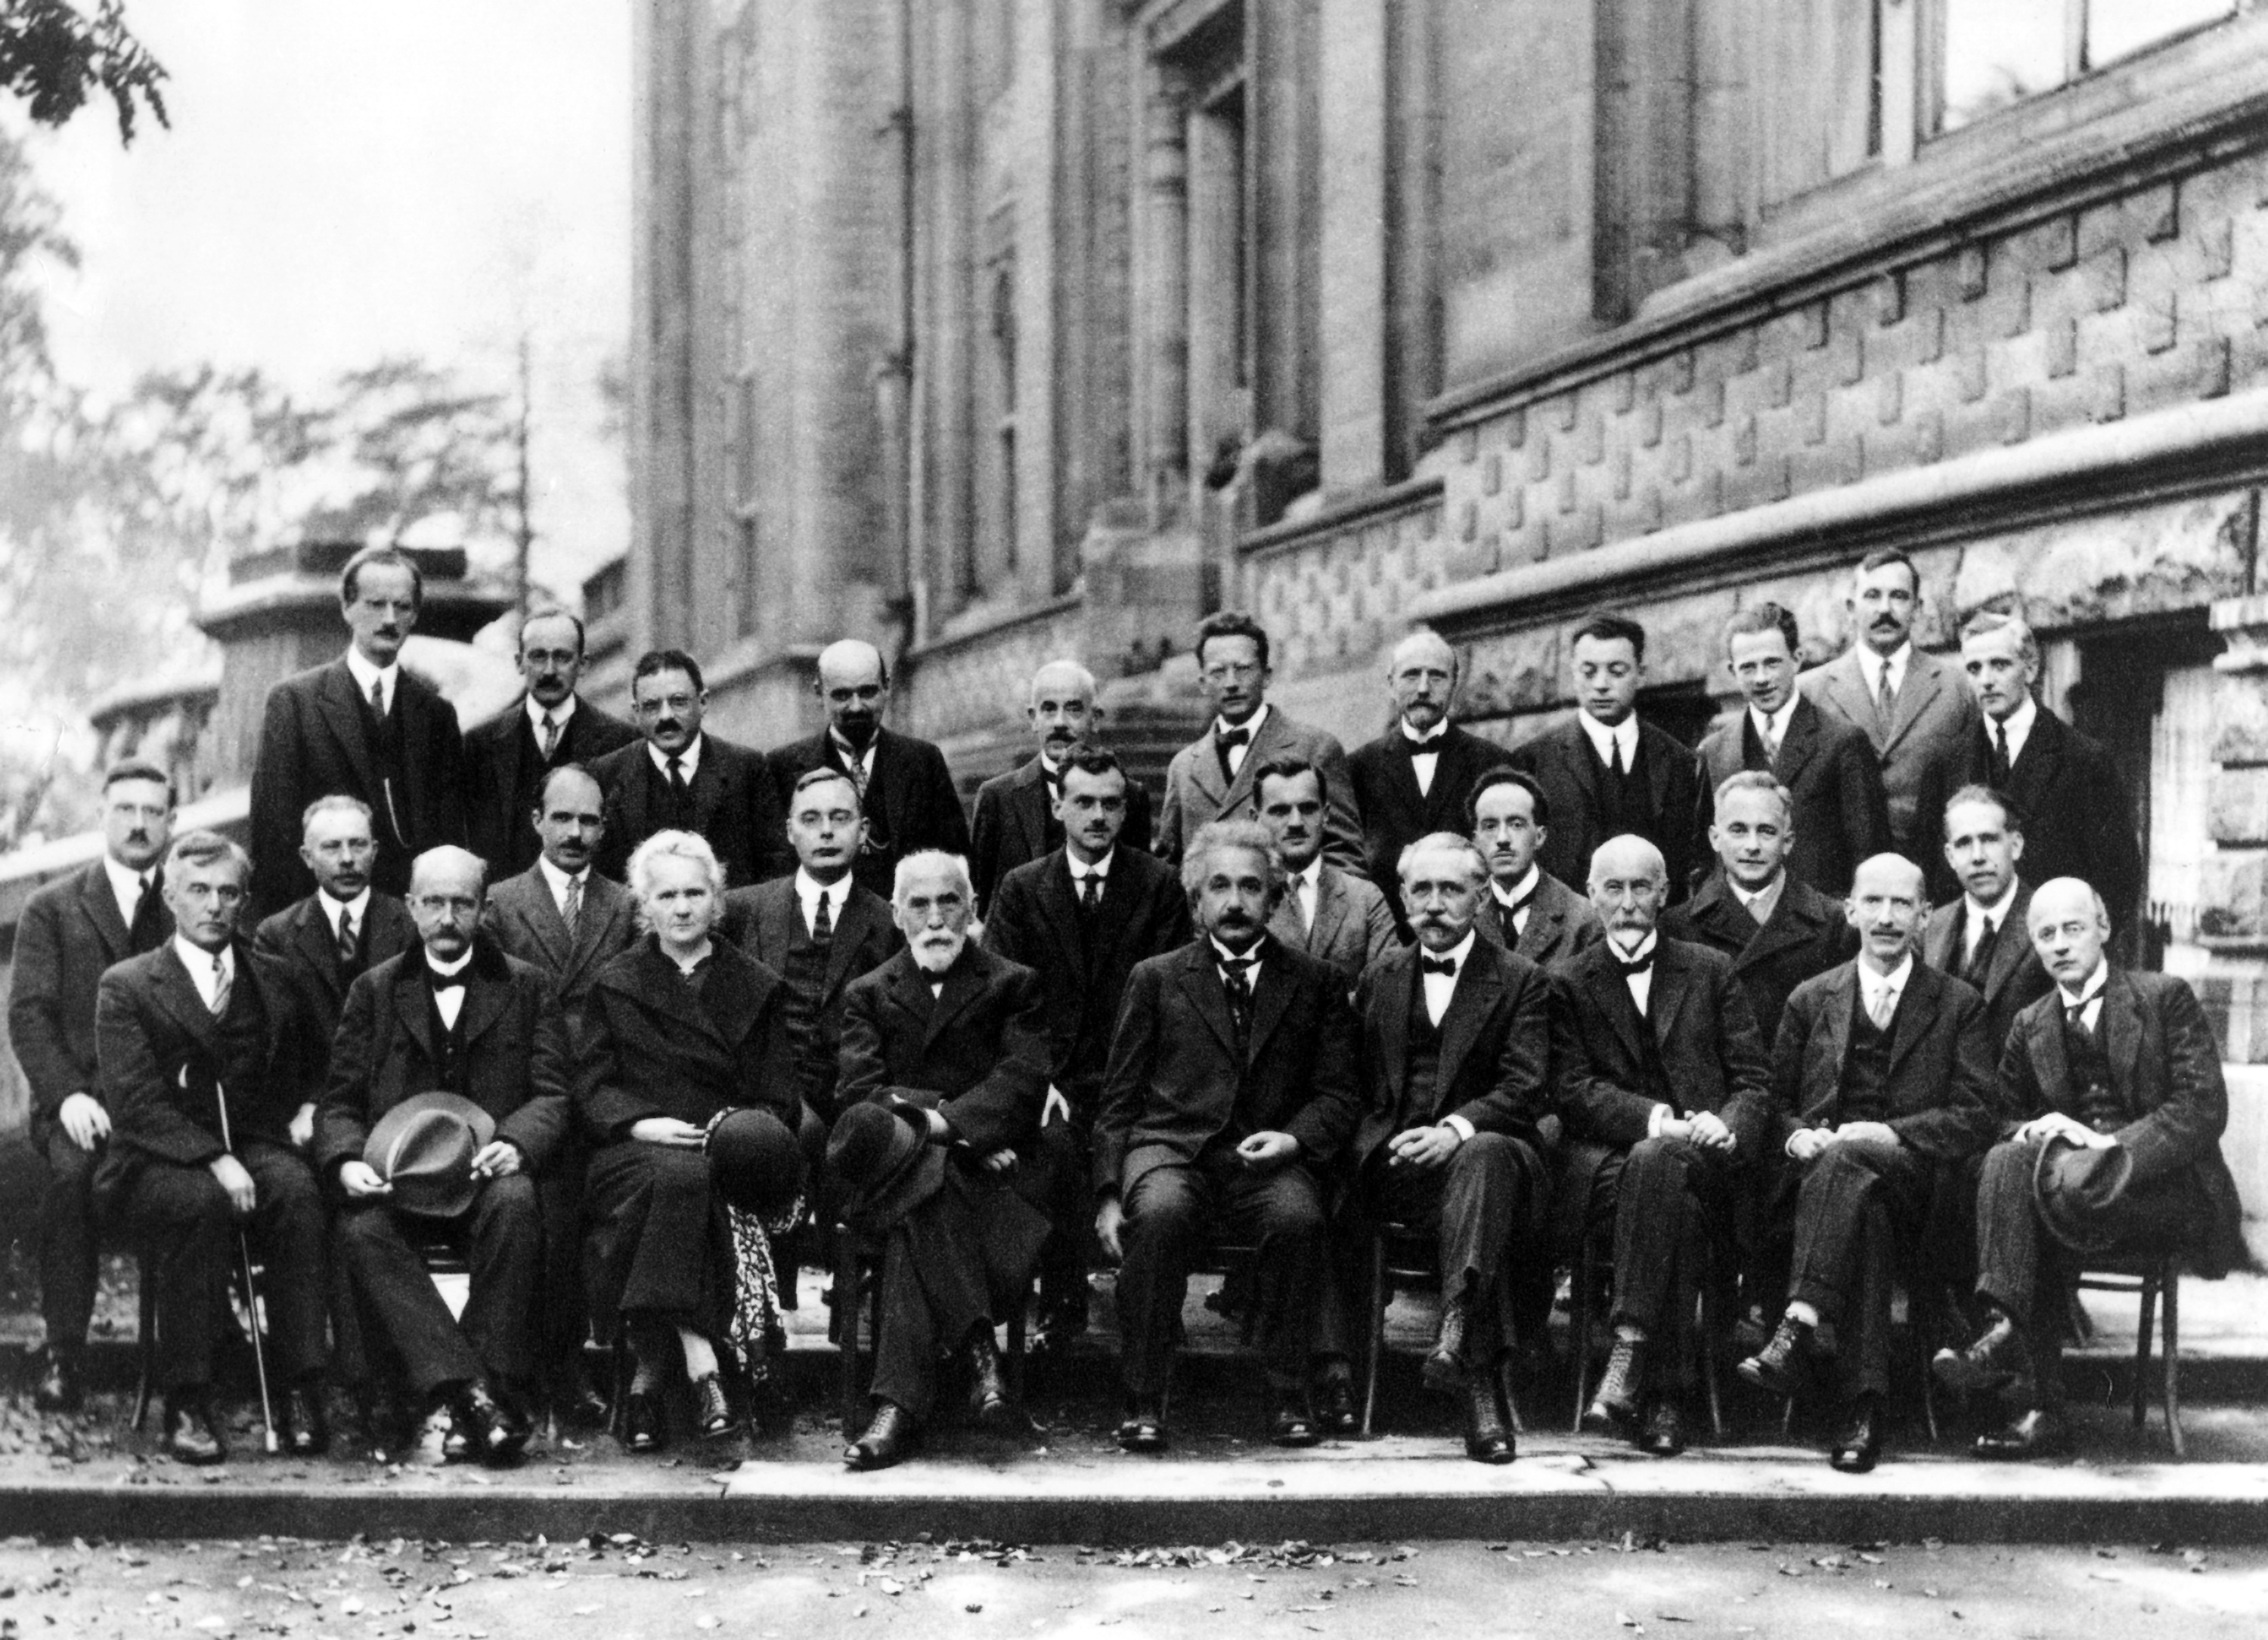
Notes:
and the October, 1927 Solvay Conference, which marked the birth of the new Quantum Theory.
(See slide 69 for names of attendees.)

Slide 4
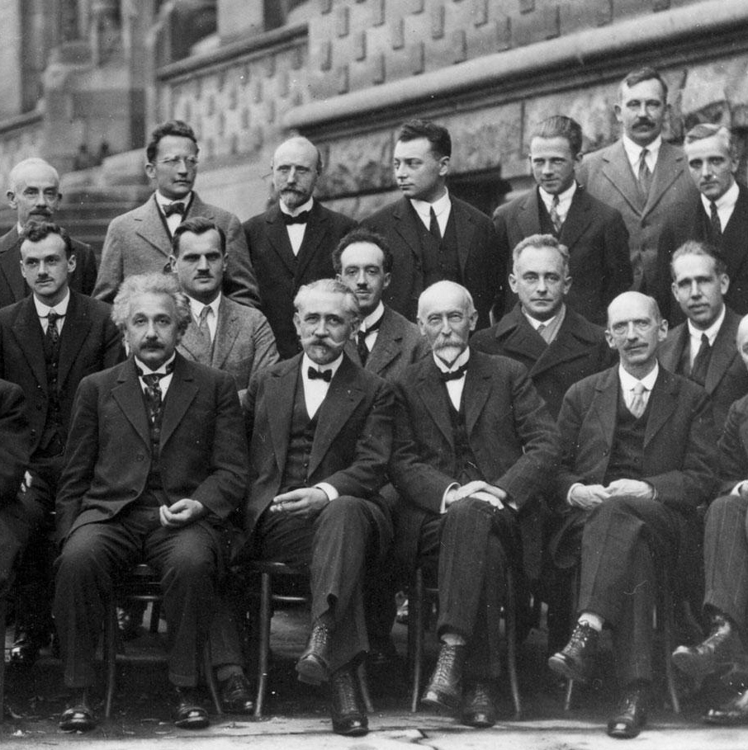
Notes:
Einstein didn't like its probabilities and uncertainties. "God doesn't play dice" he said. Bohr replied: "Einstein, stop telling God what to do".
Row 1: A. Einstein, P. Langevin, Ch.E. Guye, C.T.R. Wilson, O.W. Richardson
Row 2: P.A.M. Dirac, A.H. Compton, L.V. De Broglie, M. Born, N. Bohr
Row 3: Th. De Donder, E. Schroedinger, E. Verschaffelt, W. Pauli, W. Heisenberg, R.H. Fowler, L. Brillouin

Slide 5
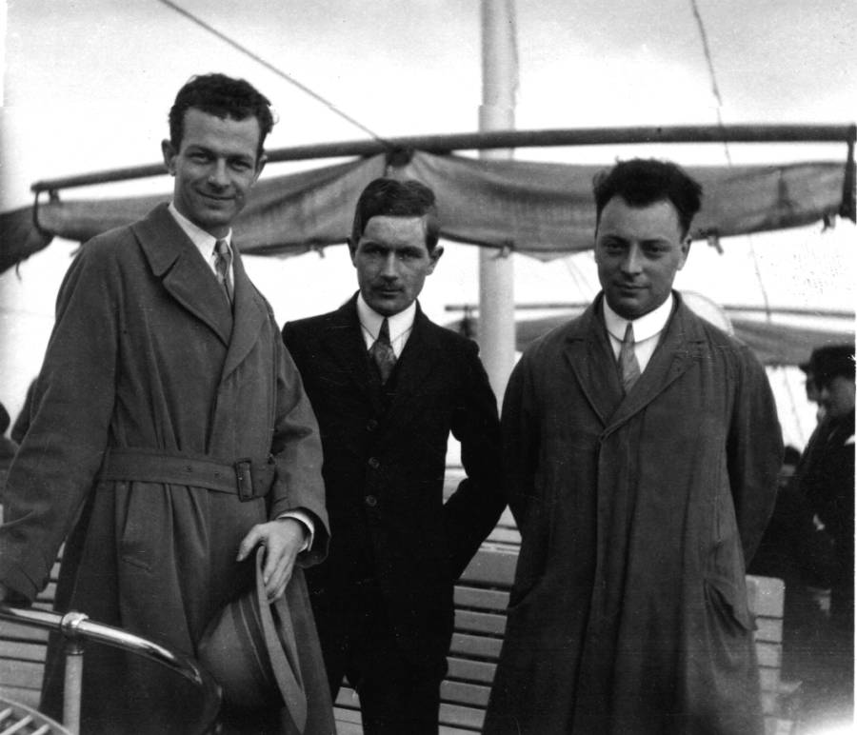
L. Pauling
W. Kuhn
W. Pauli
Notes:
Linus Pauling liked the new Quantum Mechanics. He had just spent two years mostly in Munich and visiting Gottingen, Copenhagen and Zurich

Slide 6
Notes:
to learn what Schrodinger, Pauli, Heisenberg, Dirac and other pioneers of the new quantum mechanics were up to.
Row 1: A. Einstein, P. Langevin, Ch.E. Guye, C.T.R. Wilson, O.W. Richardson
Row 2: P.A.M. Dirac, A.H. Compton, L.V. De Broglie, M. Born, N. Bohr
Row 3: Th. De Donder, E. Schroedinger, E. Verschaffelt, W. Pauli, W. Heisenberg, R.H. Fowler, L. Brillouin

Slide 7
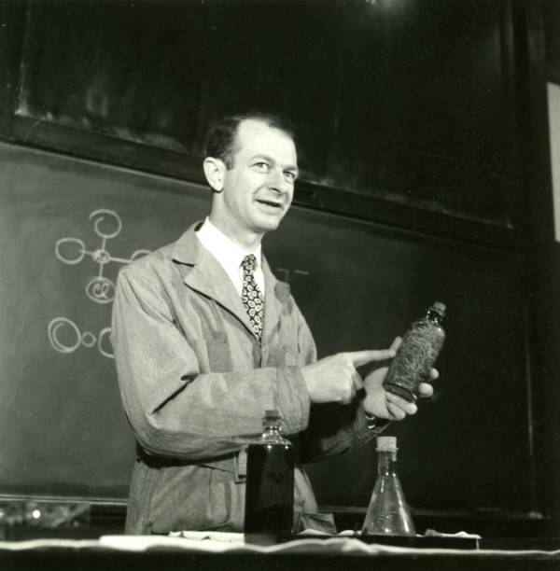
Notes:
While this meeting was in progress in October, 1927, Pauling was back in Pasadena as Assistant Professor of Theoretical Chemistry and Mathematical Physics. On the way home in September, he had stopped in England to visit the Braggs.
(Pauling lecturing at Cal Tech after his return from Munich in 1927.)

Slide 8
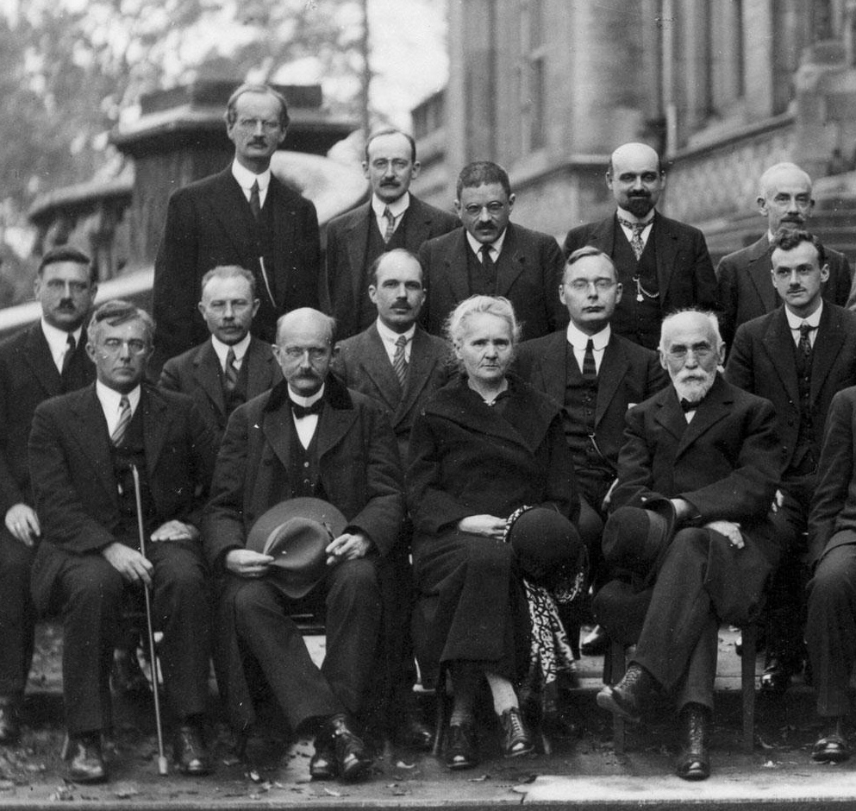
Notes:
Row 1: I. Langmuir, M. Planck, Madame Curie, H.A. Lorentz
Row 2: P. Debye, M. Knudsen, W.L. Bragg, H.A. Kramers, P.A.M. Dirac
Row 3: A. Piccard, E. Henriot, P. Ehrenfest, Ed. Herzen, Th. De Donder

Slide 9
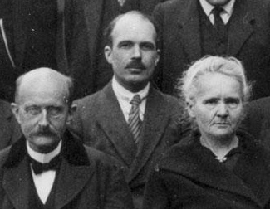
Notes:
In 1927, W L Bragg (the son) was exploring the complex and puzzling crystal structures of the silicates.
M. Planck, W.L. Bragg, Madame Curie

Slide 10
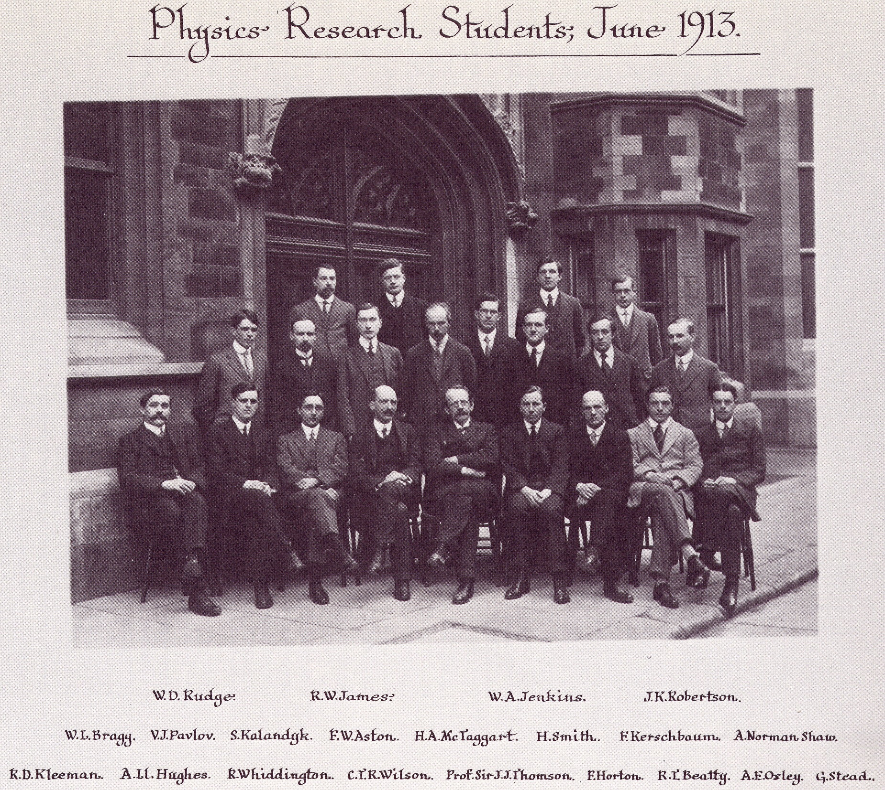
Notes:
He was using the science of x-ray crystallography he had invented in 1912 with his eponymous law. This was while he was a research student at the Cambridge University Cavendish Laboratory at the age of 22.
Notable (beside Bragg) are C.T.R. Wilson (cloud chamber), J.J. Thomson (scattering amplitude of the electron), and R.W. James (Shackleton expedition physicist 1914; author, Optical Principles of X-Ray Diffraction, 1948, the x-ray Bible; Ph.D. mentor of Aaron Klug in Cape Town).

Slide 11
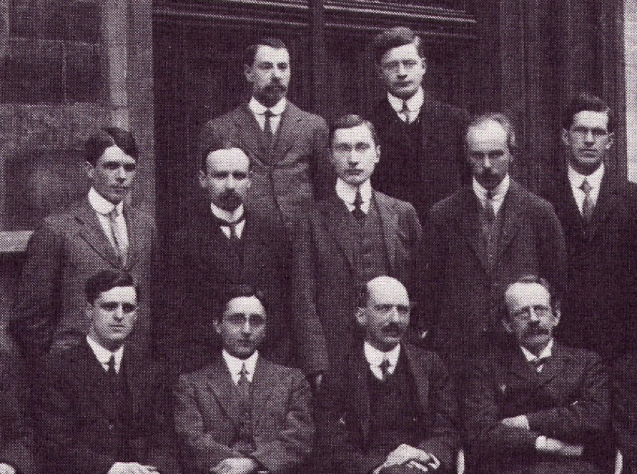
Notes:
Pauling had solved his first x-ray crystal structure in 1923, at the age of 22, while a first year graduate student at Caltech, just a decade after W L Bragg had solved the first crystal structures, the alkali halides.
(See slide 11 for names. W.L. Bragg is in the 2nd row, far left.)

Slide 12
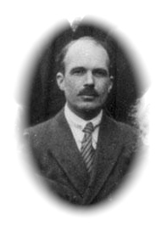
Notes:
Pauling's visit to England (just before the Solvay Conference) may have sparked his interest in the silicates, which were puzzling Bragg since the early 20s.
(Photo of W.L. Bragg)

Slide 13
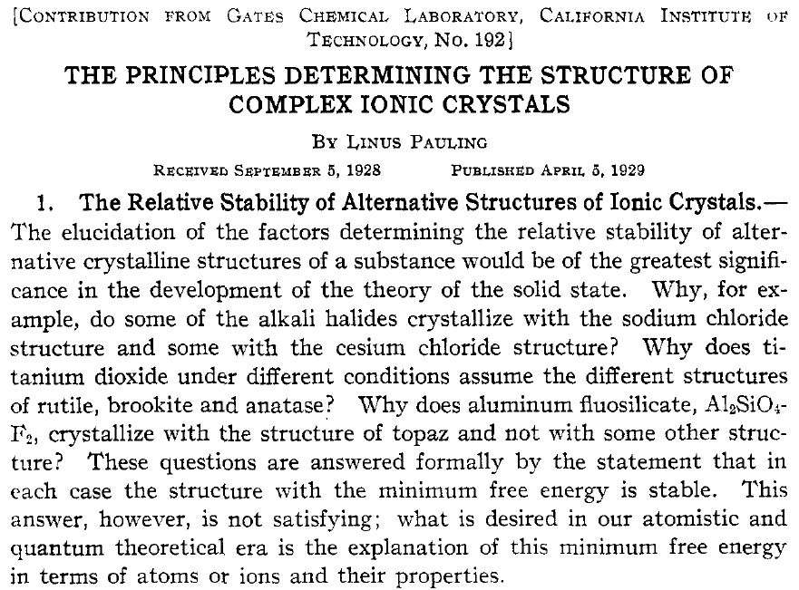
Notes:
In 1928, Pauling published his Coordination Theory of the Structure of Ionic Crystals, which to Bragg's chagrin, made sense of the silicate complexities with five simple rules.

Slide 14
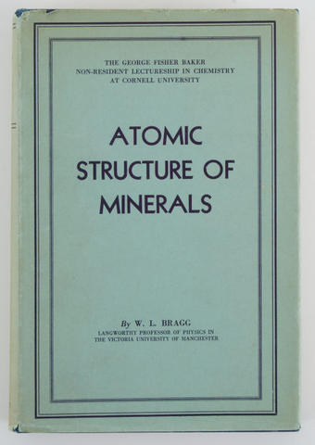
Notes:
Bragg, in his 1937 book on mineral structure, acknowledged that Pauling's electrostatic valence rule "may be termed the cardinal principle of mineral chemistry". But in 1953, the chagrin Bragg still felt about Pauling’s oneupmanship influenced the way the double helical structure of DNA was revealed – but that is later in my story.

Slide 15
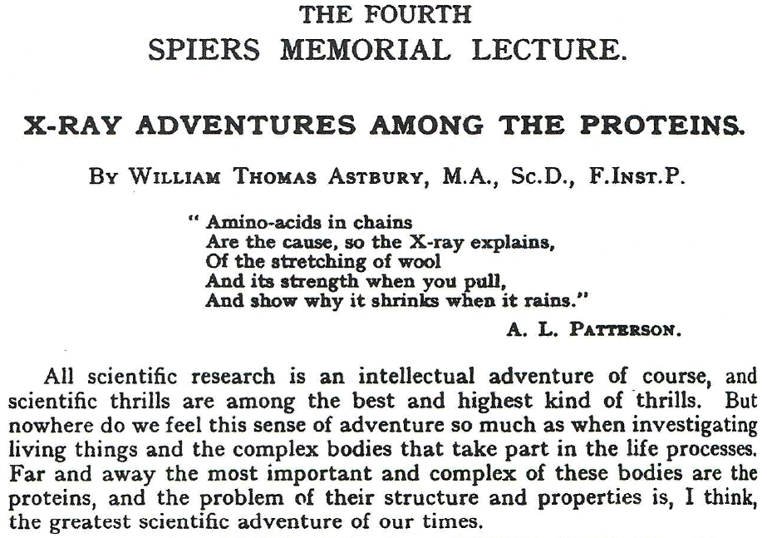
Notes:
This 1938 Faraday Society Lecture by W T Astbury summarizes his research in the Department of Textile Industries since he was appointed Lecturer in Textile Physics in 1928. Patterson’s limerick give a light hearted introduction to the enthusiasm with which Astbury approached the study of fibrous proteins.

Slide 16
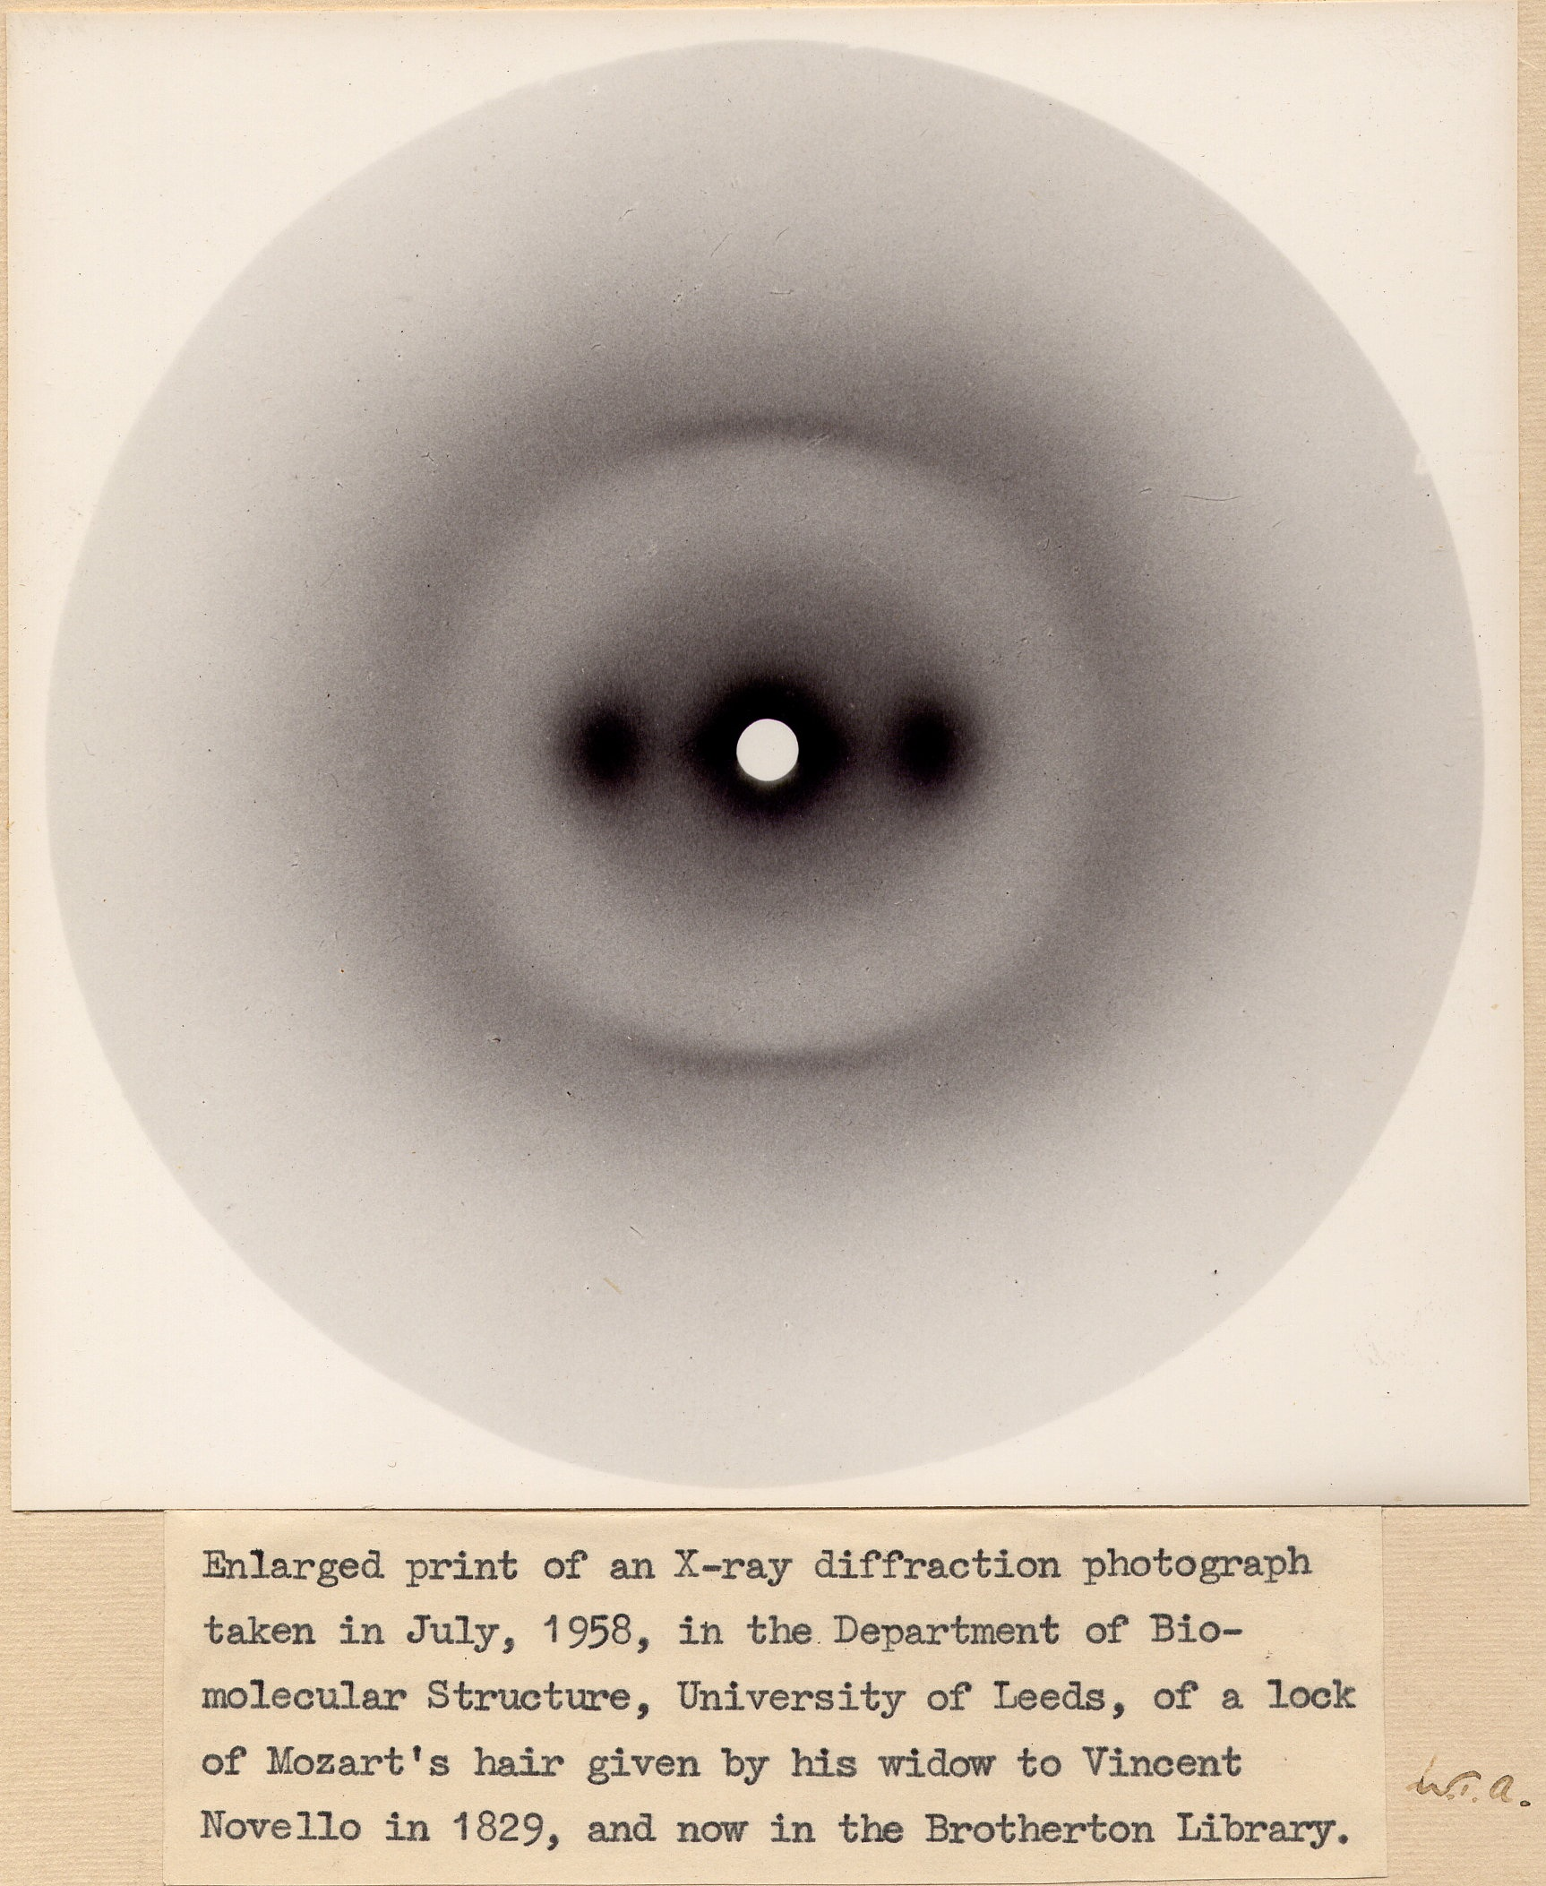
Notes:
Before Astbury left the Royal Institution in 1928, W H Bragg (the father) had asked Astbury to record an x-ray pattern from a human hair for a lecture on “the imperfect crystallization of common things”. This focused the direction of Astbury’s career on fiber diffraction. He recorded his most treasured alpha keratin fiber pattern in 1958 – 30 years after he started in Leeds – from a lock of Mozart’s hair. (His enthusiasm about this pattern stemmed from his passion for Mozart’s music.) Astbury’s diagnostics of the alpha keratin class of proteins are the 10A spacing equatorial and 5.15A meridional x-ray reflections. His 5.15 meridional spot led Bragg astray in 1950 and also influenced the way the DNA double helix was revealed. (More later)

